Slide 1
Observation CAR # 173918006

Slide 2
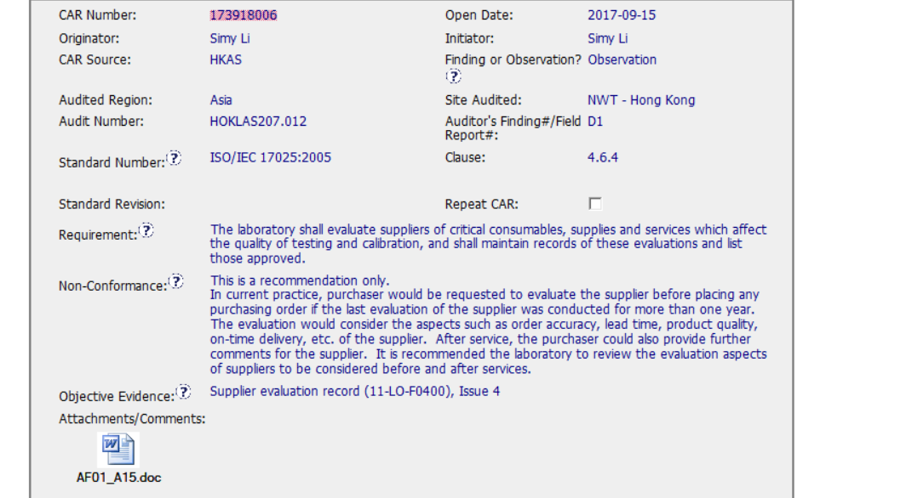
CAR review - 173918006

Slide 3
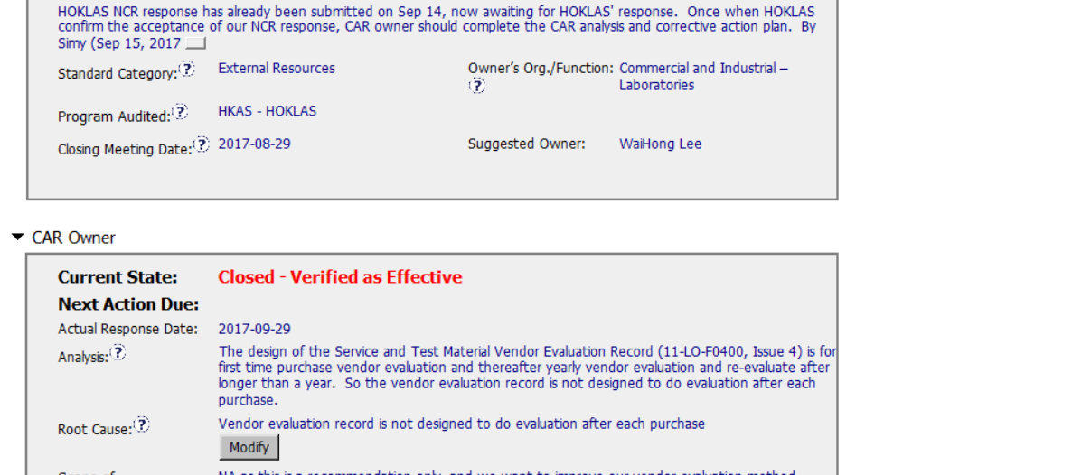
CAR review - 173918006

Slide 4
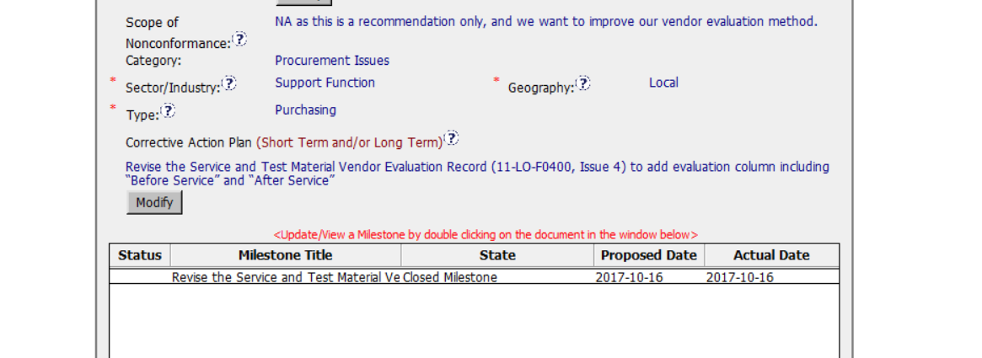
CAR review - 173918006

Slide 5
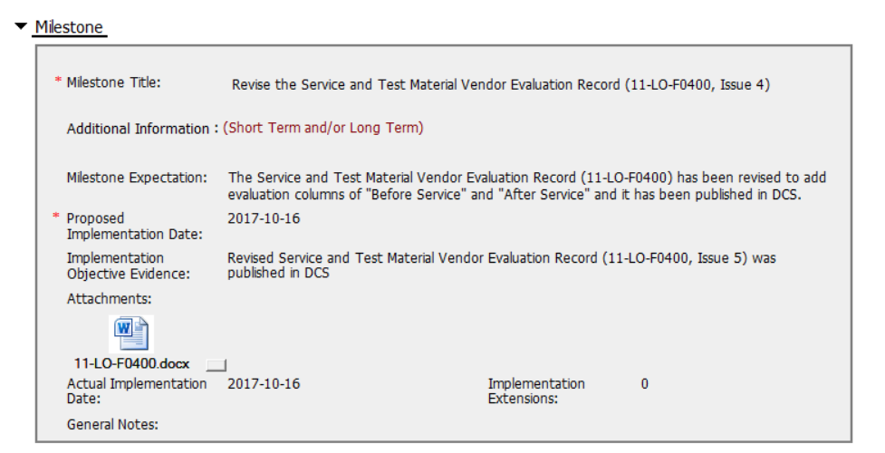
CAR review - 173918006

Slide 6
CAR review - 173918006
Does the analysis support the root cause statement?
Analysis does not include stakeholders consulted. It explained the form used to generate the records was not designed for that purpose.
Was the evidence in the milestones sufficient to confirm that the nonconformity was eliminated?
Evidence in the Milestones shows the problem was fixed (evidence of SOP including the addition of space for recording those information recommended by the auditor) so it is enough for observation CARs. The nonconformity was eliminated.

